Slide 1
Personal Finance Tracking Application
Group 9 ITIS6112/ITCS6112
Andrew Quinn
Nihar Shukla

Slide 2

Team Members
Andrew Quinn - Database developer, tester, documentor
Nihar Shukla - Front-end developer, back-end developer

Slide 3
Project Description
A personal finance tracking application focused on monthly income and expenses
Auto updating monthly summaries based on users income and expenses
Categorization of users income and expenses
Auto generated graphs based on users income and expenses
Import and export feature for bulk data
Database integration with MongoDB to allow for user account creation and data management

Slide 4
System Description, Scope, and Goal
Goal: Create a full-featured financial application from existing open-source code to enable users to track their personal finances quickly and easily
System Description: A MERN stack web application built on the MVC software design pattern and using Atlas as the database host
Scope: User account creation/log-in, user data persistence, a UI that allows users to track their budgets and financial health, data visualizations, user data transfer through import/export

Slide 5

Project Schedule
Sprint 0 - 09/18/2024
Sprint 1 - 10/02/2024
Sprint 2 - 10/23/2024
Sprint 3 - 11/06/2024
Project Demo and Presentation - 11/13/2024
Sprint 4 - 11/20/2024
Final Project and Presentation - 12/6/2024

Slide 6
User Stories
1. As a user, I want to create an account, so that I can access my financial tracking information.
2. As a user, I want to add my income and expenses, so that I can track my monthly and yearly financial activities.
3. As a user, I want to see my financial data represented in graphs, so that I can easily understand my financial patterns
4. As a user, I want to categorize my income and expenses, so that I can understand where I am earning/spending money
5. As a user, I want to import and export my financial data, so that I can back it up and transfer it between services when needed.

Slide 7
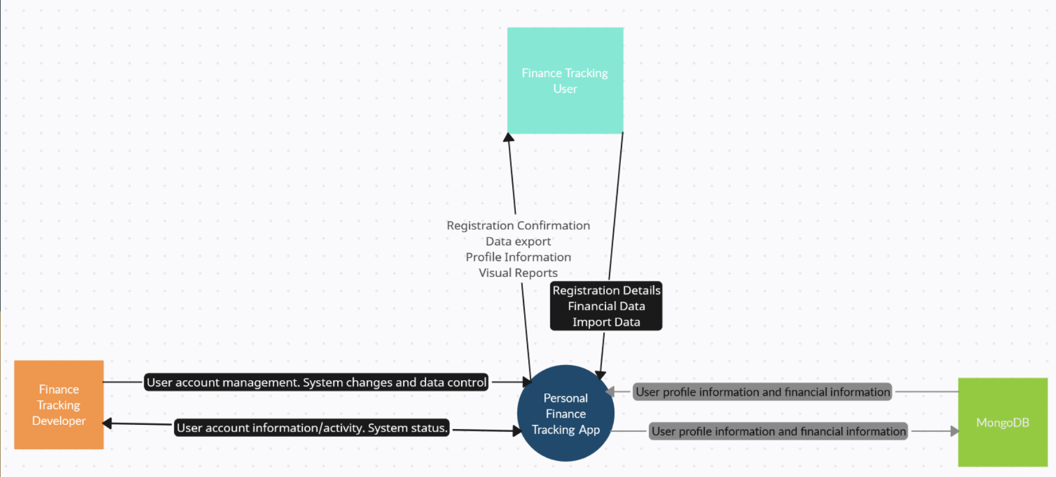
Context Diagram

Slide 8
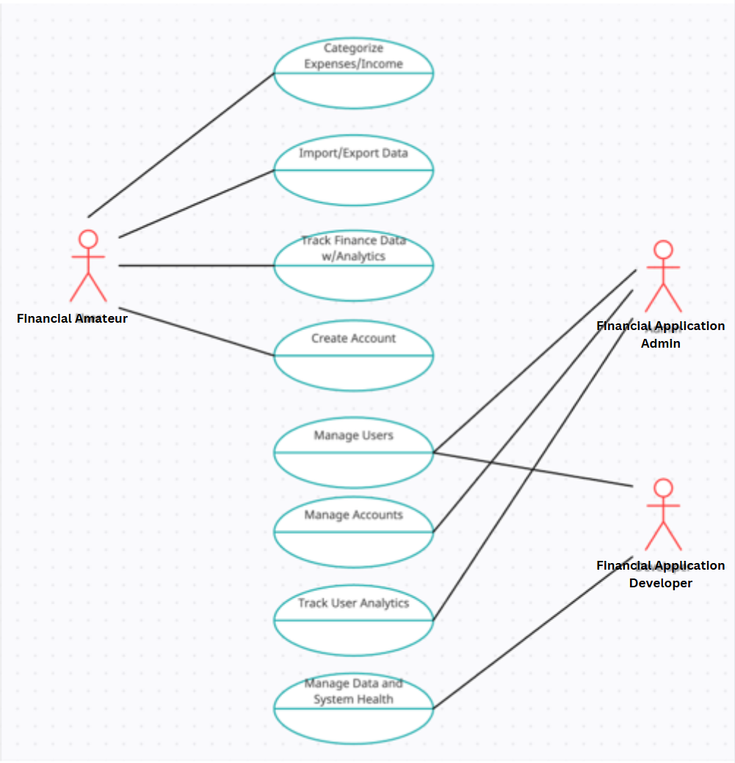
Use Case Diagram

Slide 9
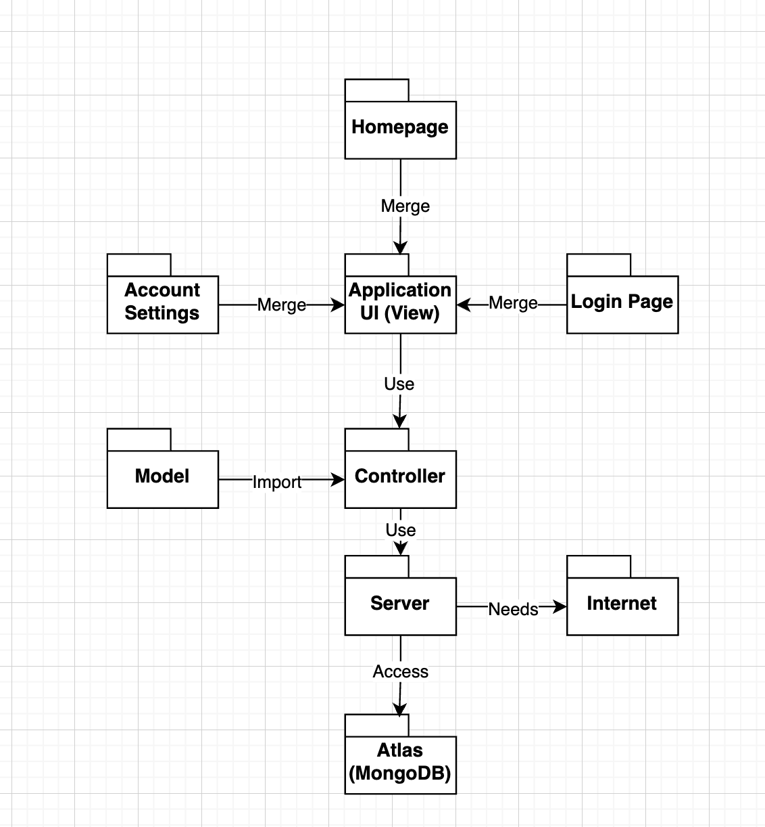
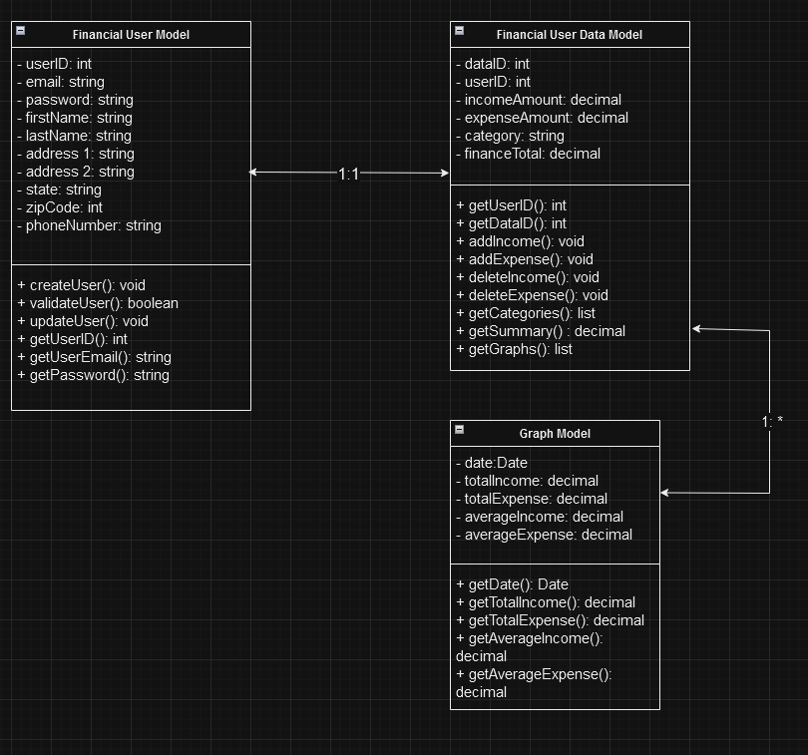
Other UML Diagrams
Subsystem Dependencies Diagram

Slide 10
State of Development: Product Backlog
Completed:
Sprint 0 - Data Modeling
Sprint 1 - Account Creation and User Profile Page
Sprint 2 - User Summary Page and Income & Expense Page
Sprint 3 - User Data Visualization
Sprint 3 - Import/Export Data Feature
Sprint 4 - Project Documentation, Additional Feature Implementation
Backlog:
N/A - All tasks completed

Slide 11
Lessons Learned
Organization and time management are key
Setting deadlines, organizing through GitHub repository and commenting on code
Planning saves time in the long run
Prioritizing tasks that might take longer and involve more work before simpler tasks
Creating a sprint schedule helps in making sure we are on schedule and can meet deadlines
Project testing and verification
Testing the application on different devices, making sure different viewports work correctly and bug fixing after each implementation

Slide 12

GitHub Link
Repo: https://github.com/Sylnus/Personal-Finance-Tracking-App
Presentation Link & Demo: https://drive.google.com/file/d/1lOEb6BHzQ1cW136lh_IUtOkFJ1yi1GPW/view?usp=sharing

